Slide 1
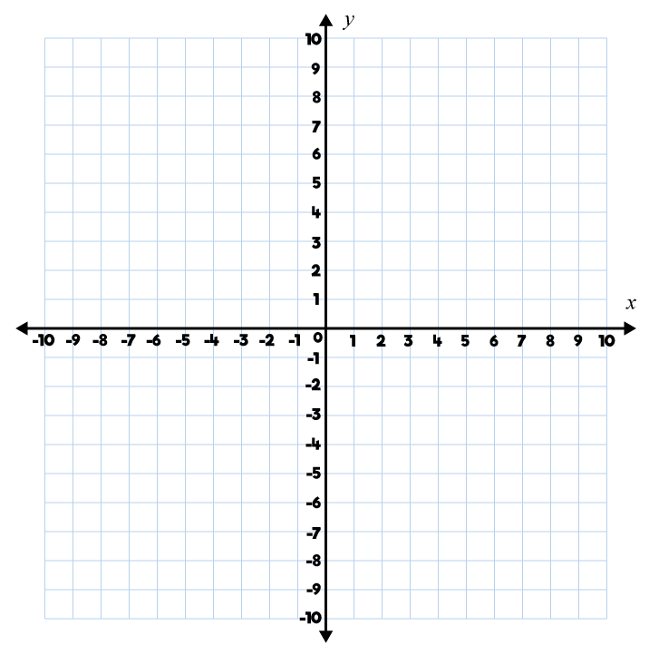
Year 5 | Week 9 | Day 1

Slide 2
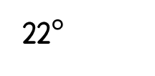

Year 5 | Week 9 | Day 2
$$x°$$
22$°$

Slide 3
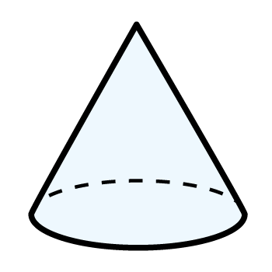
Year 5 | Week 9 | Day 3

Slide 4
Year 5 | Week 9 | Day 4

Slide 5
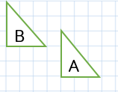
Year 5 | Week 9 | Day 5

Slide 6
Year 5 | Week 10 | Day 1

Slide 7
Year 5 | Week 10 | Day 2

Slide 8
Year 5 | Week 10 | Day 3

Slide 9
Year 5 | Week 10 | Day 4

Slide 10
Year 5 | Week 10 | Day 5

